Slide 1
RFVLSI-Lab Chip Implementation Guidelines

Slide 2
Introduction
Don’t work in your dorm or in your office cube. Please work in our war room.
Follow implementation guidelines.
Don’t get mad or impatient with your team members.
Help your team members, and help check each other’s design.
Check with your boss consistently.
You will be kicked of the lab right away if you fail to do this.

Slide 3
Unsmooth Design Flow

Slide 4
Not Following Power Rail Practices

Slide 5
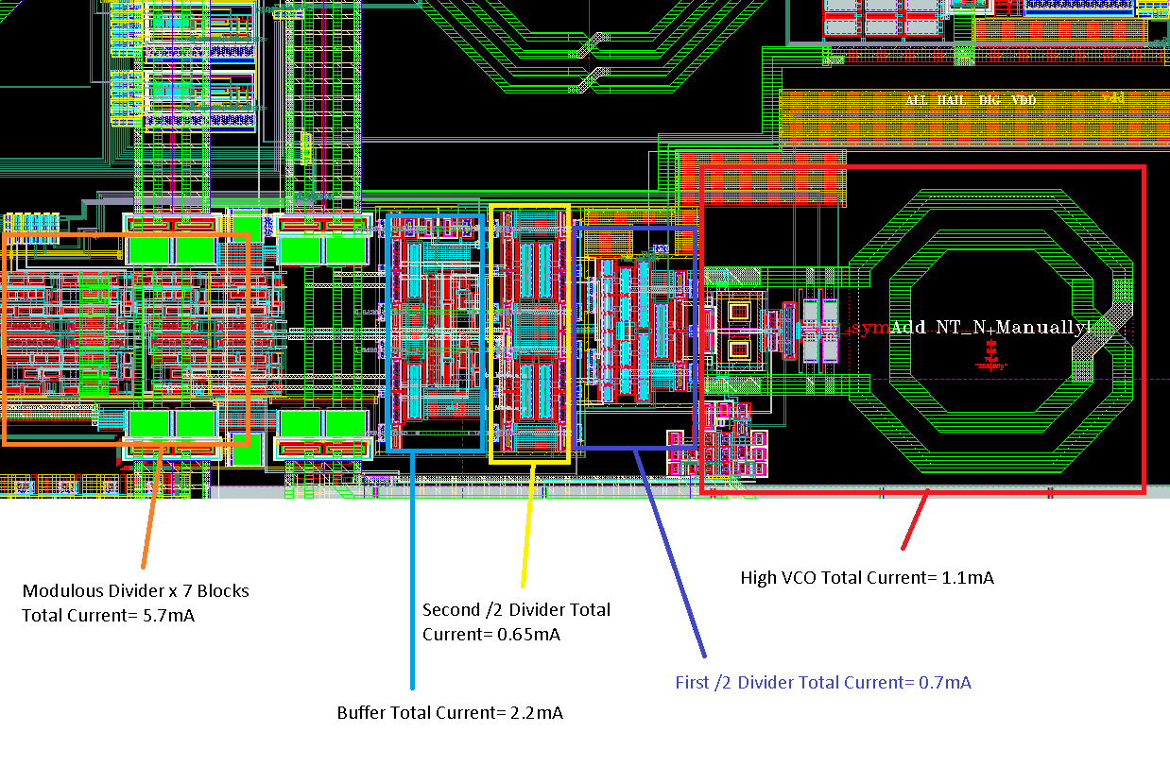
High Band T otal Current

Slide 6
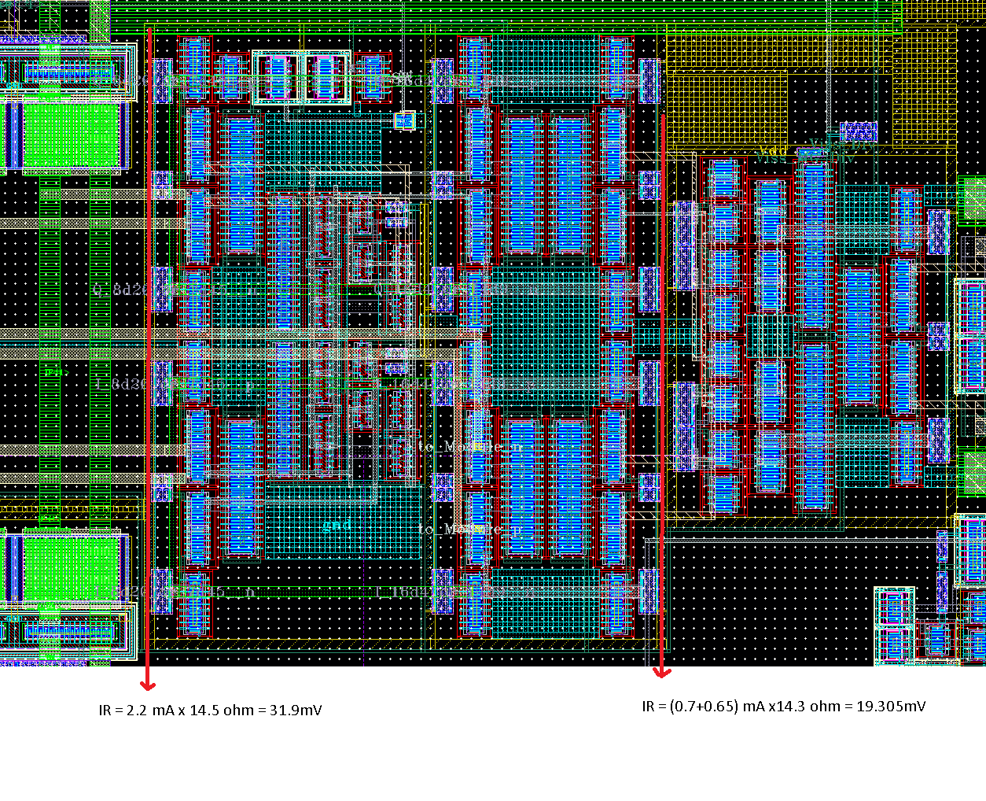
High Divider IR Drop

Slide 7
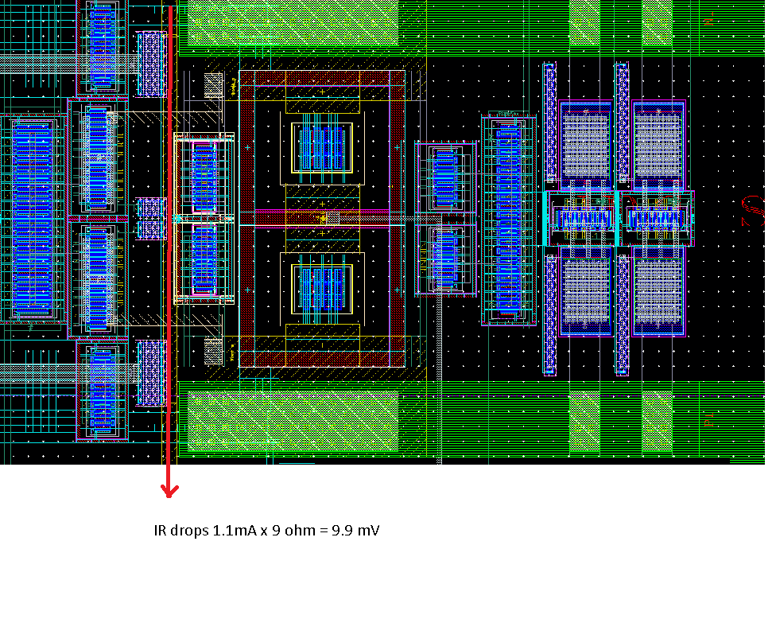
High VCO IR Drop

Slide 8
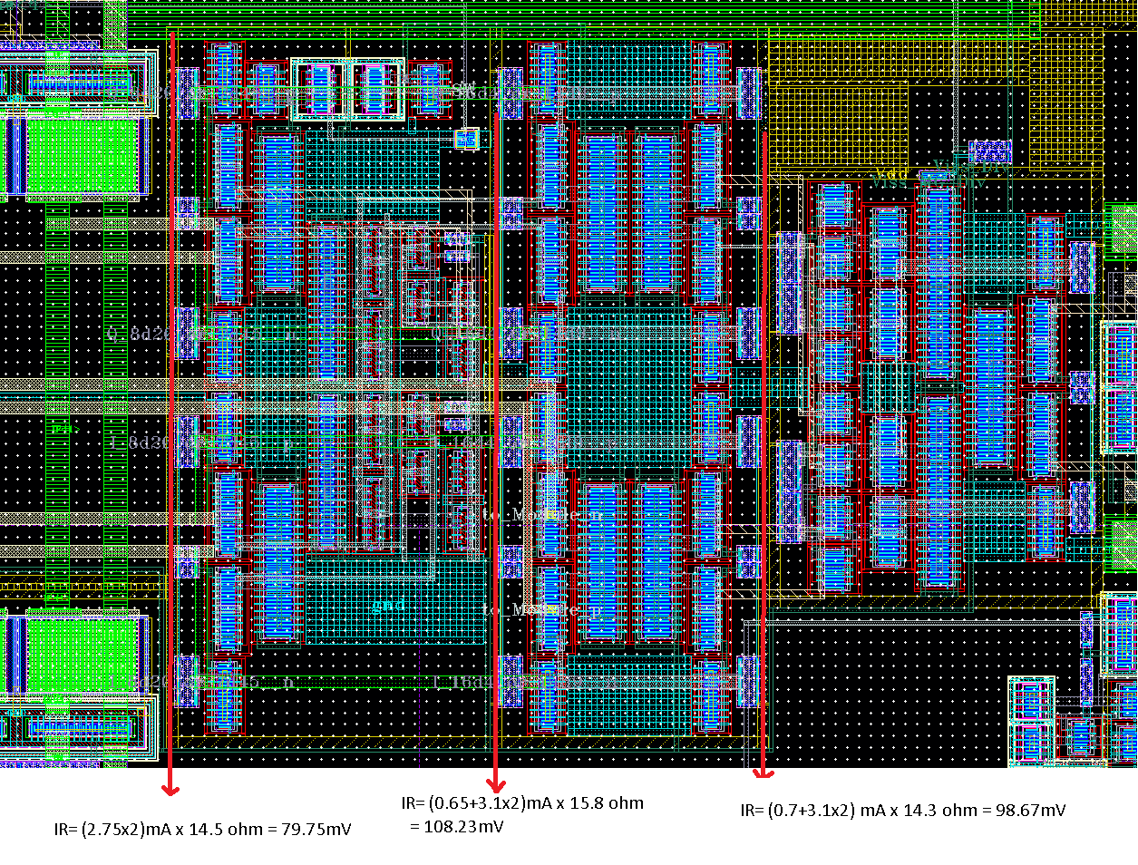
High Divider IR Drop

Slide 9
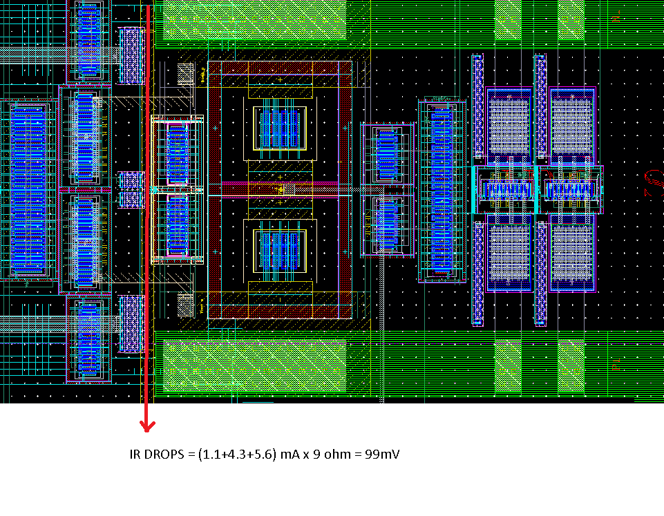
High VCO IR Drop

Slide 10
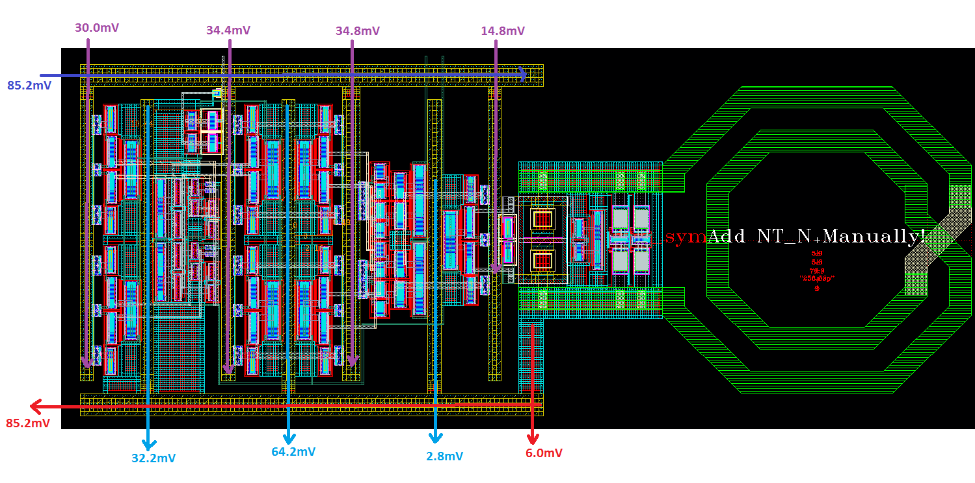
High VCO IR Drop

Slide 11
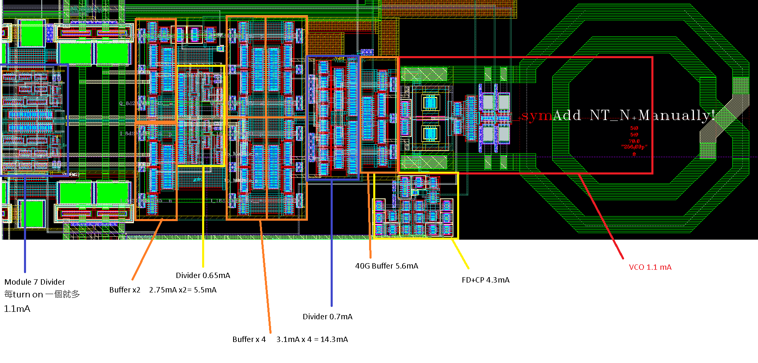
Discontinuous Ground Network

Slide 12
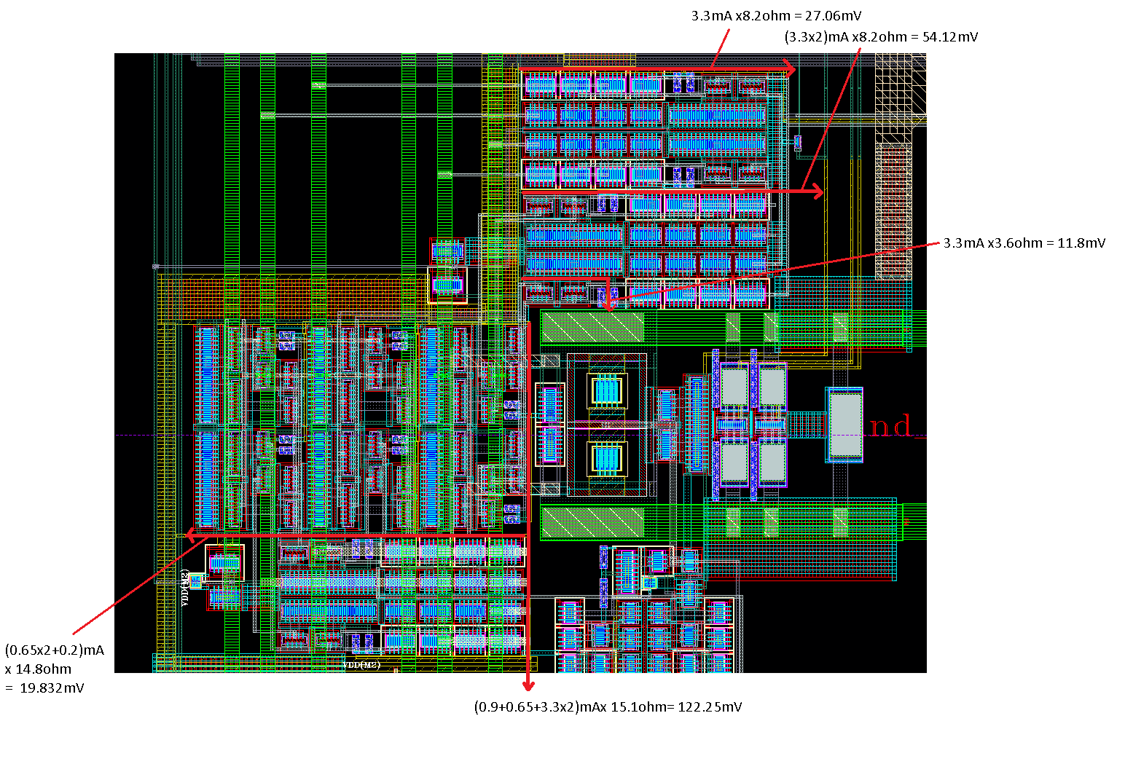
Low-Band IR Drop

Slide 13
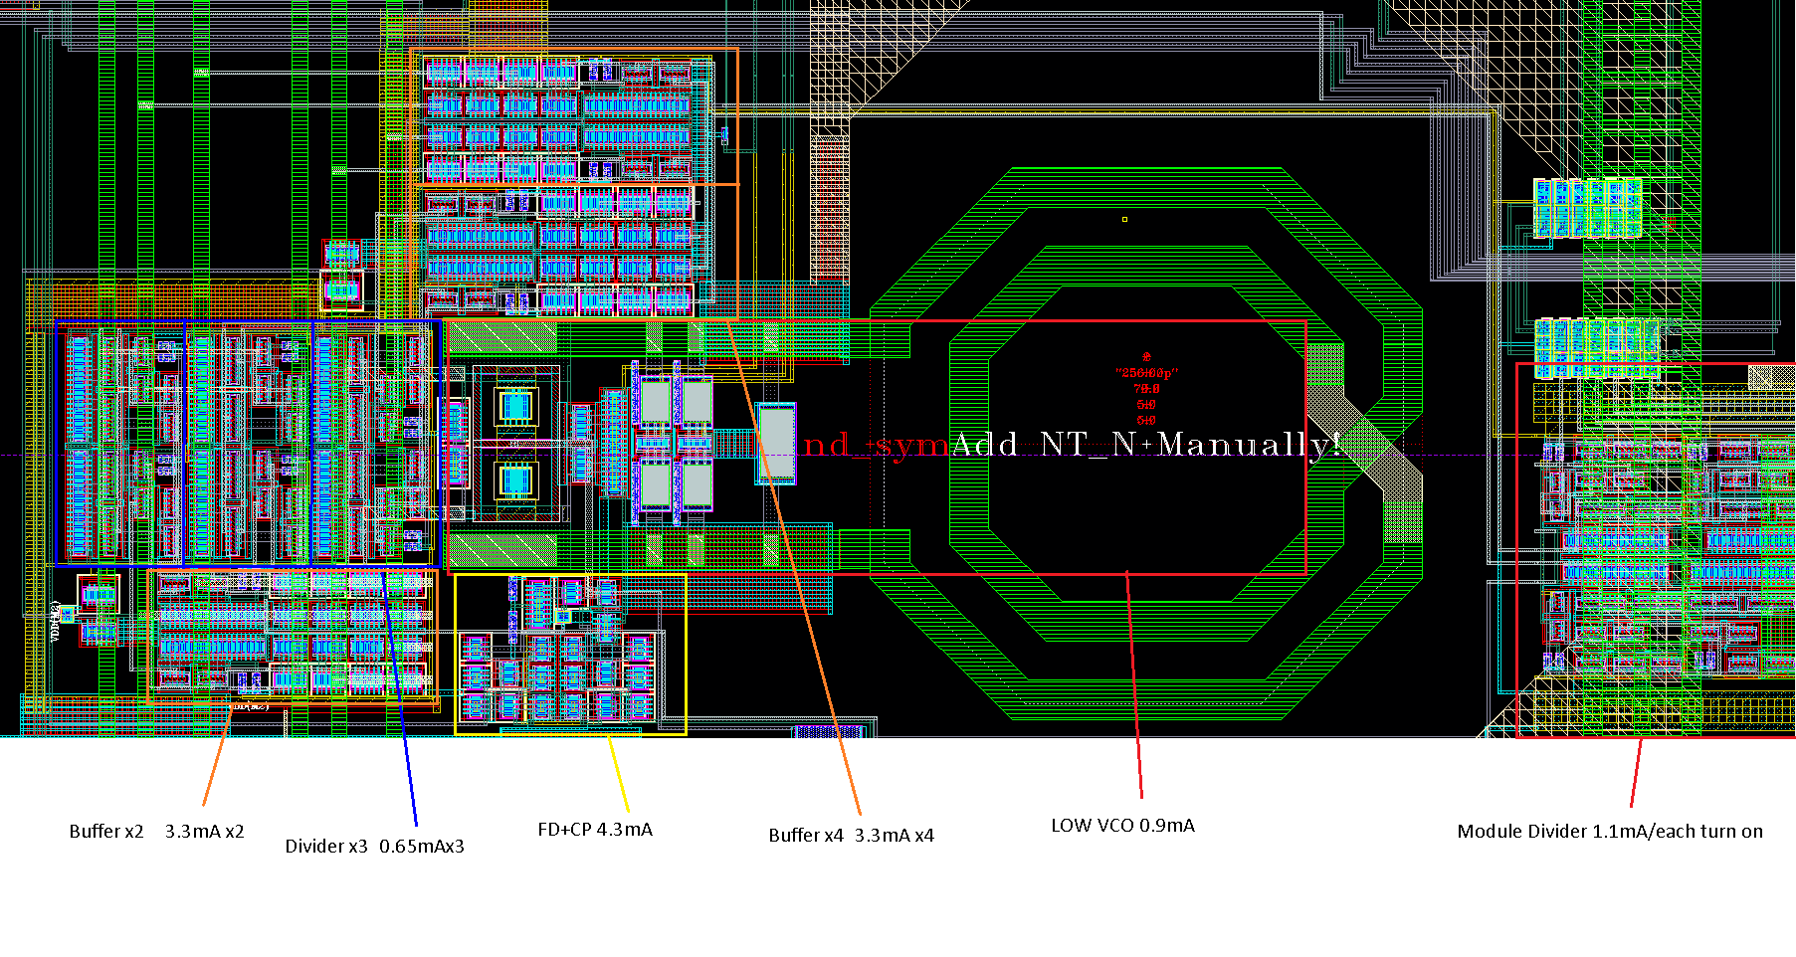
Low VCO Total Current

Slide 14
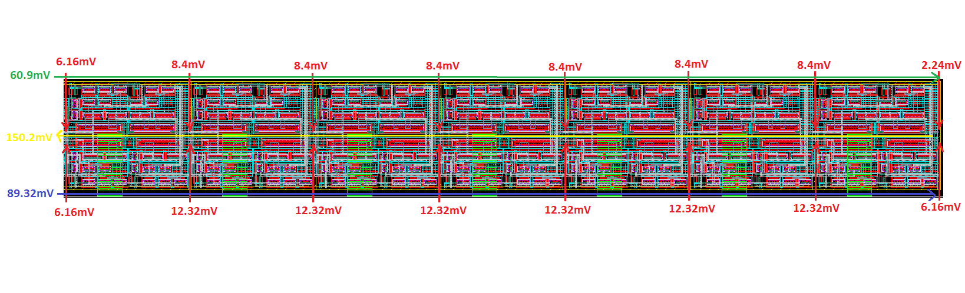
BD Module IR Drop

Slide 15
Results
Failed Chip Due to IR drop.
Waste Eight Months of Time
One Additional Run.

Slide 16
Sheep’s Conclusion
Hiarachcy: put PADs on most TOP
PADS>Digitals>RF System>RF circuits.
I/Q, positive, negative, well define.
Don’t use I<0>, use IN_I_p_high stead
If the <+> <-> substitute each other, then LVS will pass, but it is totally wrong.
Don’t use VDD array ➔ Dump problem to Top.
Put NTN on the most TOP??
Pin placement will overflow. (double check this problem. )

Slide 17
Conclusion
Whoever in RFVLSI repeat this error, will be kicked out the lab right away.

